Slide 1
Chi-Square & ANOVA Analysis Forbes Best Employers 2023
Naheed SAJJAD
Stuti Patel
Advanced Stats for Analytics
13 August 2025

Slide 2
Introduction
This project analyzes the 'Forbes Best Employers 2023' dataset using three statistical methods:
1. Chi-Square Test for Goodness of Fit
2. Chi-Square Test for Homogeniety/Independence
3. One-Way ANOVA with Tukey's HSD & Barplot
Goal: Explore relationships between industry,
country, and employee size.

Slide 3
Chi-Square Goodness of Fit Test
The Chi-Square Goodness of Fit test checks if the observed distribution of a categorical variable matches an expected distribution.
It is used for a single categorical variable.
This is a type of hypothesis test where we will follow the 4-step procedure:
State the null and alternative hypotheses
Check the assumptions and conditions
Calculate the test statistic
Make a decision using p-values or critical values.
Notes:
The chi-square goodness of fit test checks if the differences between observed and expected values are just due to random chance or if the model doesn’t fit the data.

Slide 4
Chi-Square Test Statistic
Assumtions & Conditions
Counted Data Condition
Independence Assumption
Randomization Condition
Expected Cell Frequency/Sample Size Condition
Chi-Square Formula:
Where:
O = Observed frequency
E = Expected frequency
Σ = Sum over all categories

Slide 5
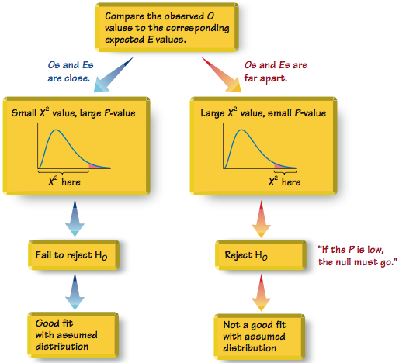
Relationships Among the Test Statistic, P-Value, and Goodness-of-Fit
Notes:
A close agreement between observed and expected values will lead to a small value of chi-square and a large P-value.
A large disagreement between observed and expected values will lead to a large value of chi square and a small P-value.
A significantly large value of chi-square will cause a rejection of the null hypothesis of no difference between the observed and the expected.
“If the P is low, the null must go.”

Slide 6
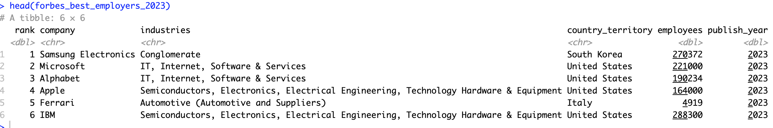
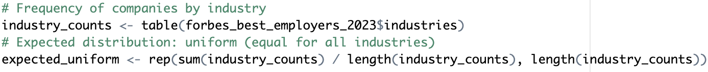
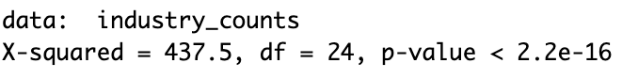
Example: Distribution of companies across industries
Using the forbes_best_employers_2023 dataset, test whether the distribution of companies across industries is uniform. Perform a Chi-Square Goodness of Fit test using the industries column, and interpret the results.
H₀:The distribution of companies across industries is uniform
H_{A}:The distribution of companies across industries is not uniform
Since p-value < 0.05 → reject H₀
Notes:
I only used the p-value method for the chi-square test.
H₀: The distribution of companies across industries is uniform — i.e., each industry has the same proportion of companies.
H_{A}: The distribution of companies across industries is not uniform — i.e., at least one industry’s proportion of companies differs from the expected equal proportion.
Since the p-value is far less than 0.05, we reject H₀ and conclude that the distribution of companies across industries is significantly different from a uniform distribution.

Slide 7
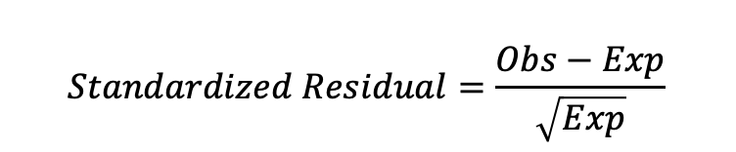
Determining Where the Model Doesn’t Fit
Only when the null is REJECTED, you can use the following methods to determine how the observed and expected distributions are different:
Residuals
Close to 0 :Normal difference.
Larger than ±2 : Unusual difference.
2. Grouped Bar Plots
$$Standardized Residual=\frac{Obs−Exp}{\sqrt{Exp}}$$

Slide 8
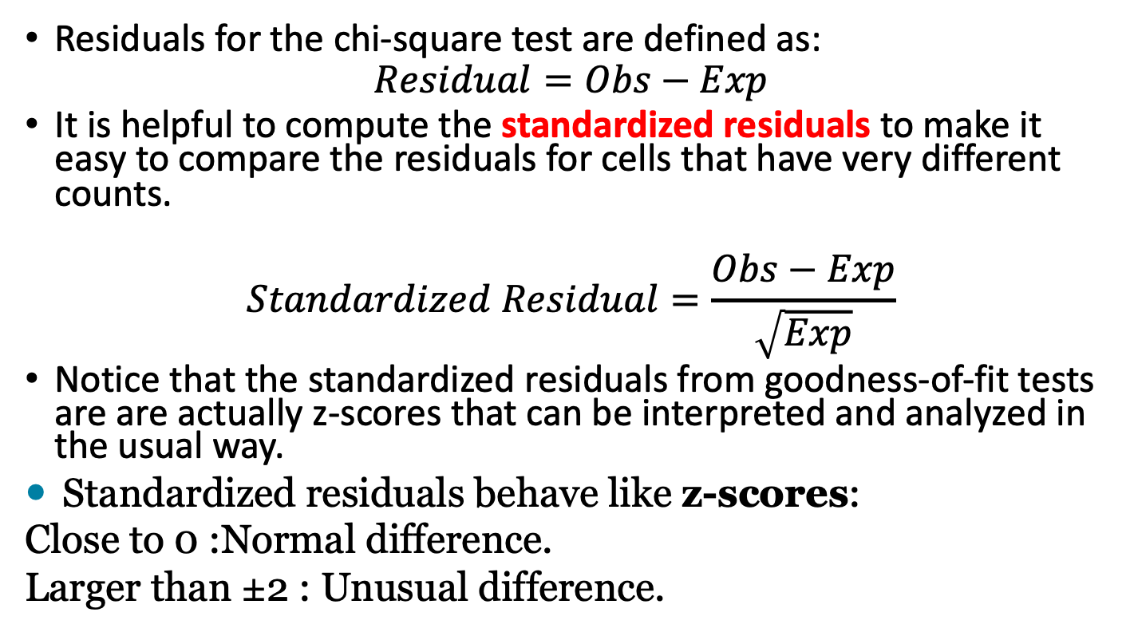
Examining the Residuals
Residuals for the chi-square test are defined as:
$$Residual=Obs−Exp$$
It is helpful to compute the standardized residuals to make it easy to compare the residuals for cells that have very different counts.
$$Standardized Residual=\frac{Obs−Exp}{\sqrt{Exp}}$$
Notice that the standardized residuals from goodness-of-fit tests are are actually z-scores that can be interpreted and analyzed in the usual way.
Standardized residuals behave like z-scores:
Close to 0 :Normal difference.
Larger than ±2 : Unusual difference.

Slide 9
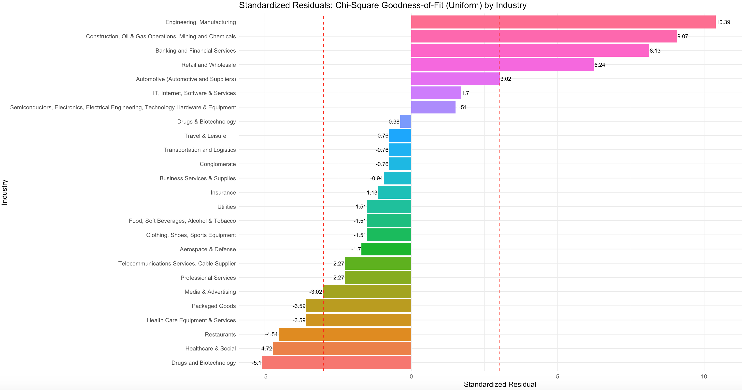
Bar Plots To Examine Residuals
A bar plot can be created to show the magnitude of the residuals as well as the relationship relative to the mean
Negative residual = lower than the mean value
Positive residual = greater than the mean value
Notes:
Only when the null is REJECTED, you can use the following methods to determine how the observed and expected distributions are different:
Residuals
Grouped Bar Plots

Slide 10
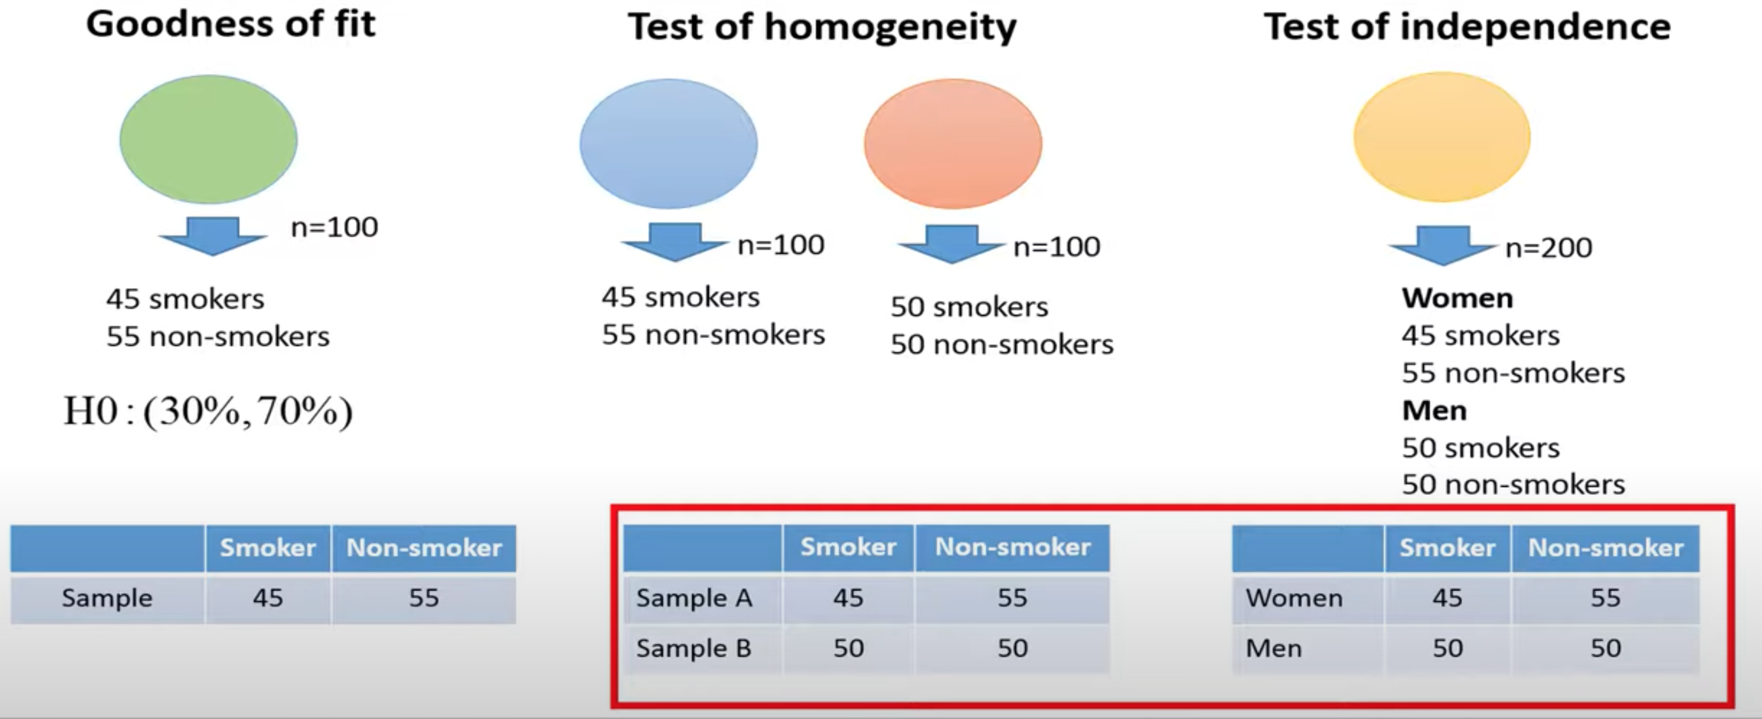
Chi-Square Test for Independence/Homogeneity
A type of Chi-Square (χ²) test used to determine if there is a relationship between two categorical variables is called the chi-square test for independence/homogeneity.
Notes:
Homogeneity: samples are drawn from more than one populations for one categorical variable
Independence: one dataset with observations classified by two categorical variables.

Slide 11
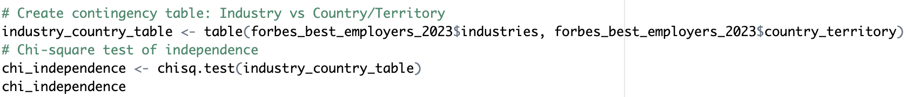
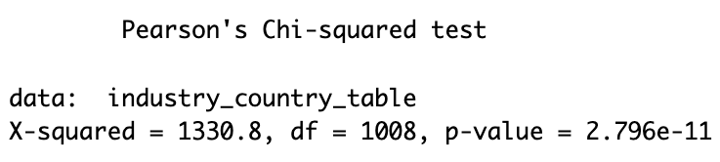
Example: Association between industry and country
Using the forbes_best_employers_2023 dataset, test whether the distribution of industries is the same across different countries. Perform a Chi-Square test and interpret the results.
H₀: Industry and Country are independent.
H_{A}: Industry and Country are related.
Result: p-value << 0.05 → Reject H₀
Interpretation: Industry distribution differs significantly by country.

Slide 12
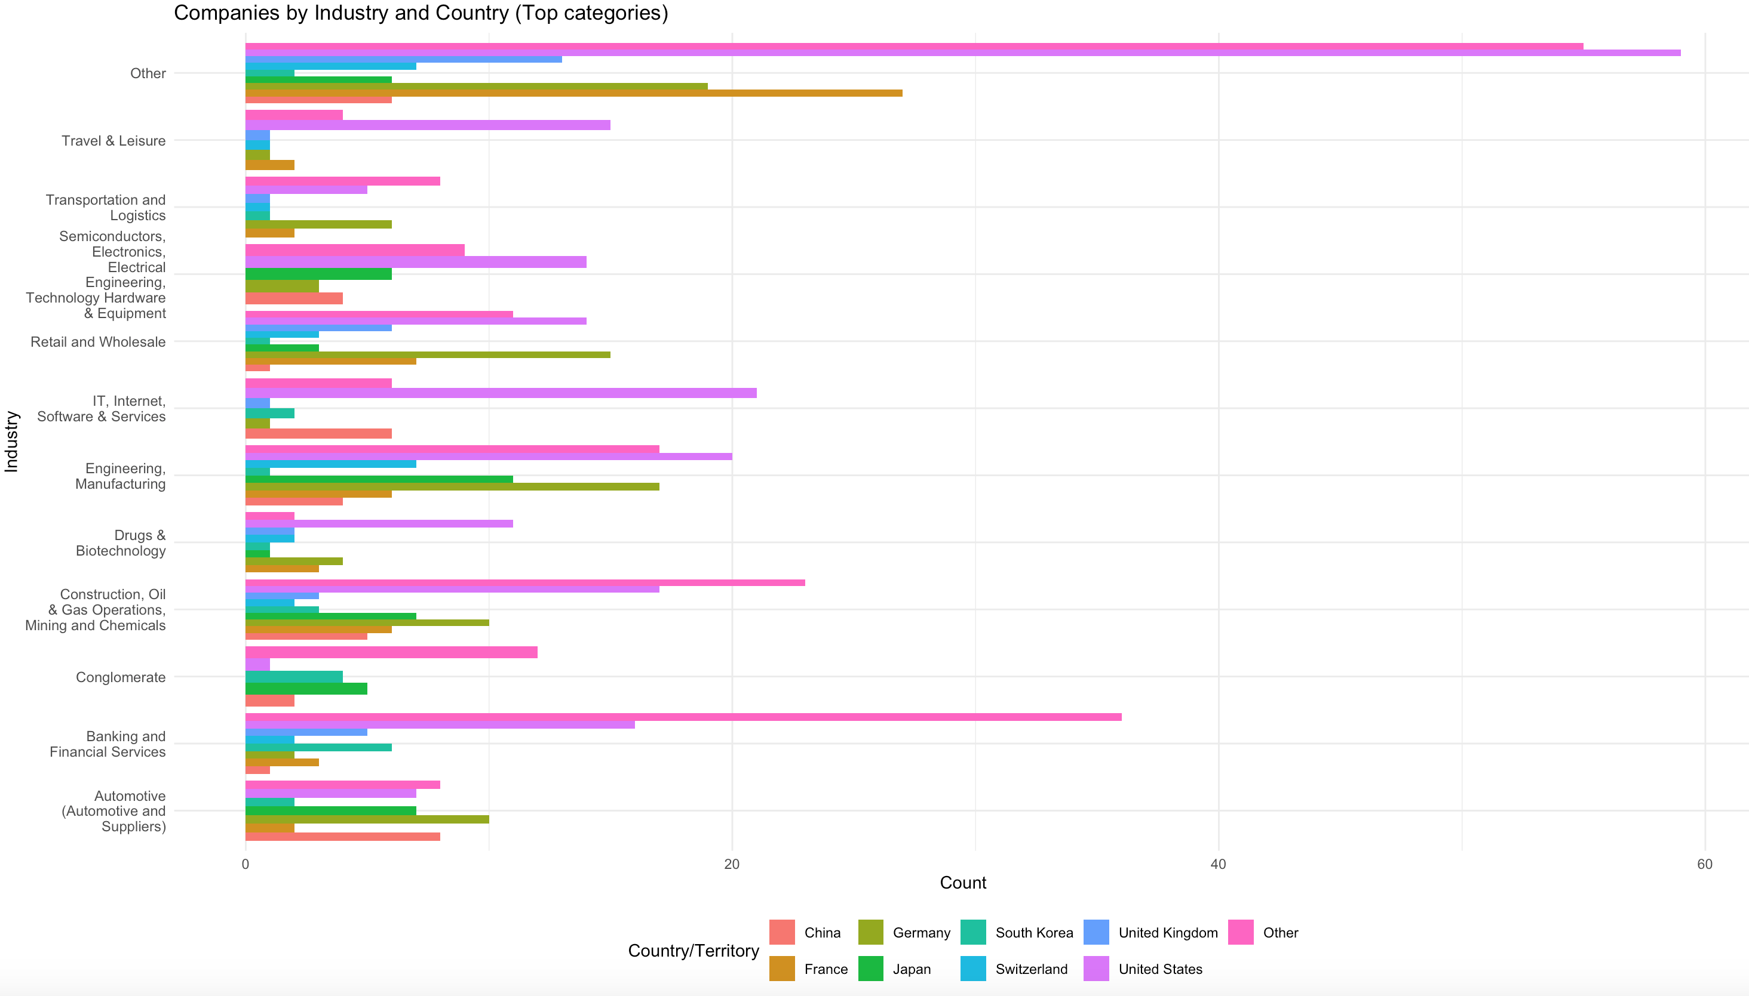
Grouped Bar Plots
Notes:
A grouped bar plot can be created to show the observed and expected distributions.
These plots can help to determine if the distribution are similar (the null hypothesis is true) or where difference in the distributions occur.
Plots To Examine Residuals
There are two types of plots that can be used to examine residuals for bivariate categorical data
Association Plot
Mosaic Plot

Slide 13
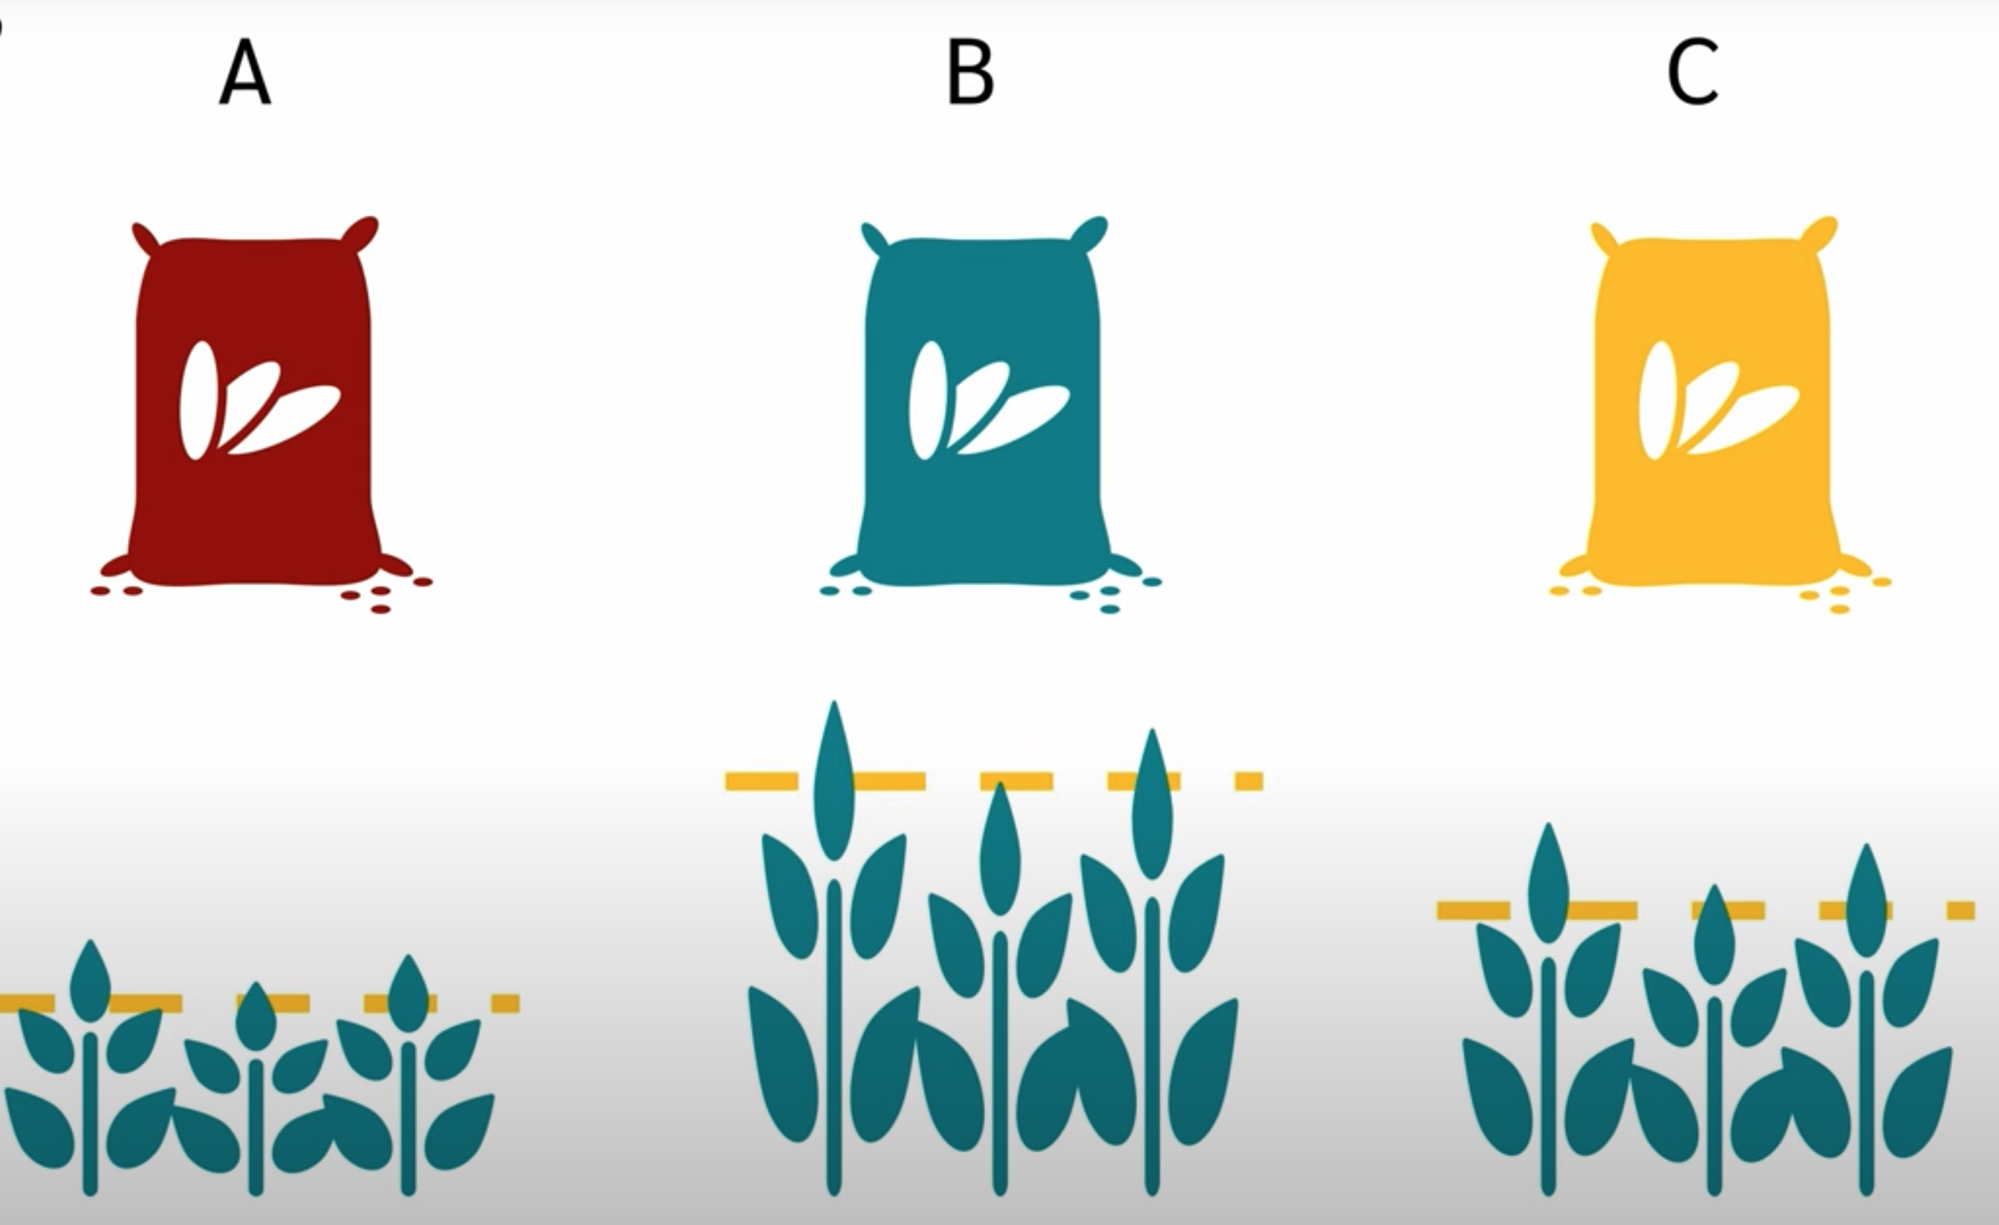
One –Way ANanlysis Of VAriance
When the groups have little variation within themselves, but large variation between them, it would appear that they are distinct and that their means are different.
Notes:
What is one-way ANOVA?
One-way ANOVA (Analysis of Variance) is a hypothesis test used to determine whether there are any statistically significant differences between the means of three or more independent (unrelated) groups.
Example:
Whether there is a difference between fertilizers A, B and C in terms of plant growth. The Analysis of Variance will help you to find out whether there is a significant difference between the three groups.
T-test do the same thing for two groups, → ANOVA is an extension for three or more groups.

Slide 14
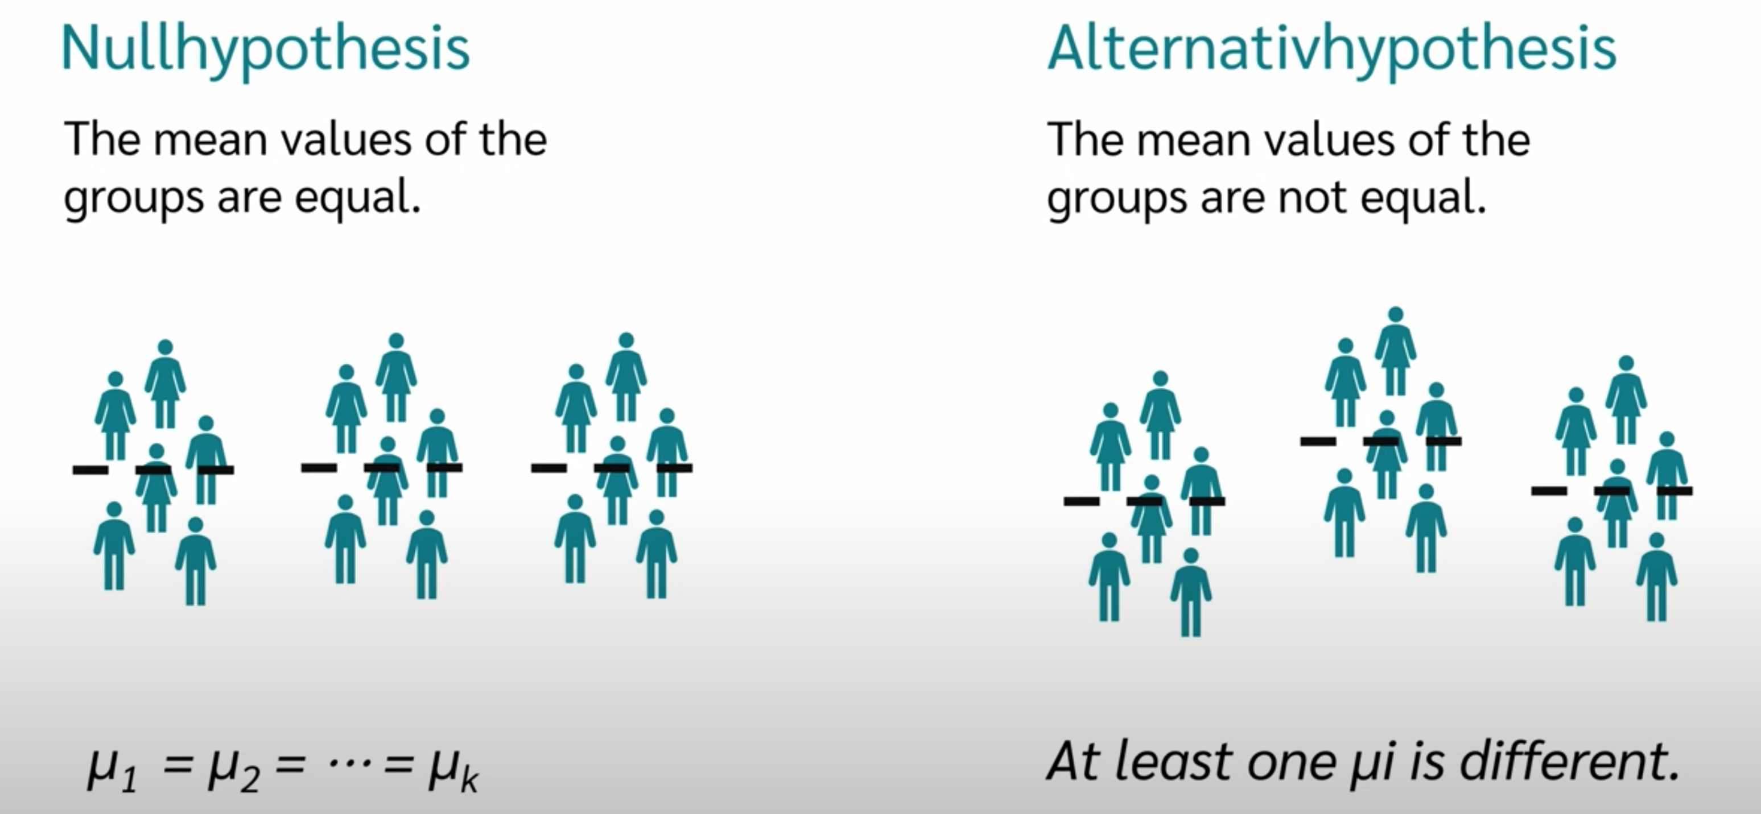
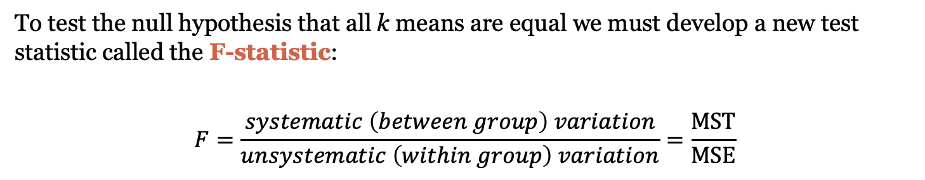
Hypothesis tested in an ANOVA
To test the null hypothesis that all k means are equal we must develop a new test statistic called the F-statistic:
$$F=\frac{systematic \left(between group\right) variation}{unsystematic \left(within group\right) variation}=\frac{\text{MST}}{\text{MSE}}$$
Notes:
“We start with hypotheses: H₀ states that all group means are equal, while H₁ suggests that at least one group mean differs.
To test whether there is a difference, the ANOVA uses the ratio of the variance between the groups and the variance within the groups.
When the groups have little variation within themselves, but large variation between them, it would appear that they are distinct and that their means are different.

Slide 15
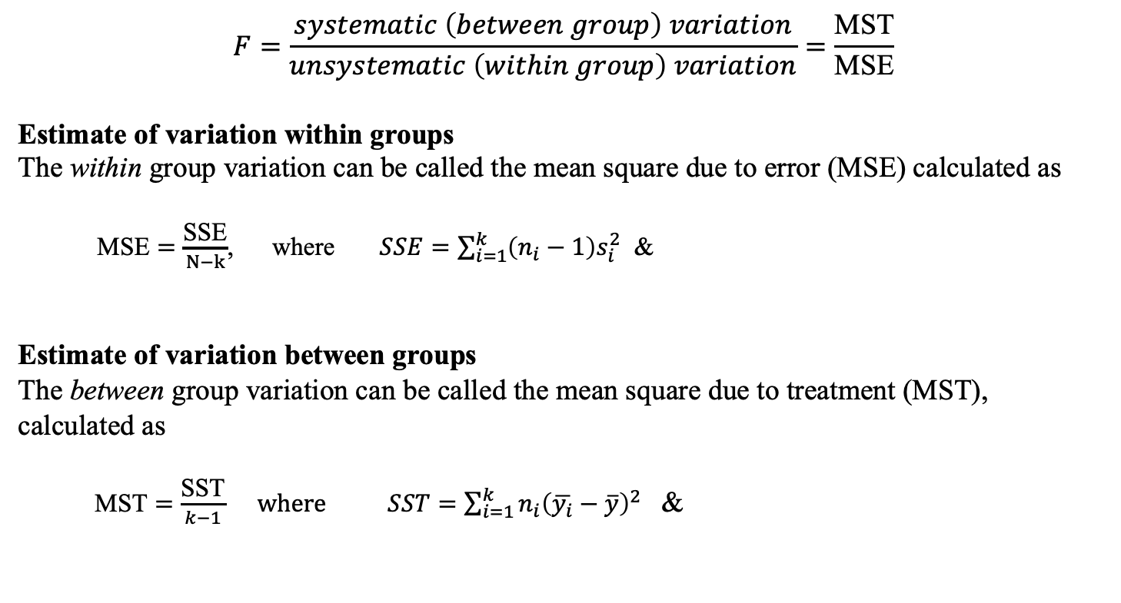
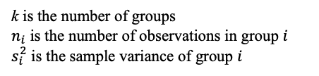
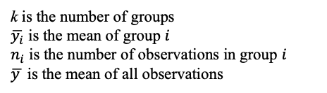
The F-statistic
$$F=\frac{systematic \left(between group\right) variation}{unsystematic \left(within group\right) variation}=\frac{\text{MST}}{\text{MSE}}$$
Estimate of variation within groups
The within group variation can be called the mean square due to error (MSE) calculated as
$\text{MSE}=\frac{\text{SSE}}{N−k}$, where $SSE=\sum_{i=1}^{k}{\left(n_{i}−1\right)s_{i}^{2}}$ &
Estimate of variation between groups
The between group variation can be called the mean square due to treatment (MST), calculated as
$\text{MST}=\frac{\text{SST}}{k−1} where SST=\sum_{i=1}^{k}{n_{i}{\left(\overline{y_{i}}−\overline{y}\right)}^{2}}$ &
k is the number of groups
$n_{i}$ is the number of observations in group $i$
$s_{i}^{2}$ is the sample variance of group $i$
k is the number of groups
$\overline{y_{i}}$ is the mean of group $i$
$n_{i}$ is the number of observations in group $i$
$\overline{y }$ is the mean of all observations
Notes:
For manual calculation

Slide 16
The One-Way ANOVA Table
To results of the analysis of variance are summarized in a table:
aov( values ~ group variable, data)
Note that SSTotal = SST + SSE
Must be in long format
Notes:
This is what a typical ANOVA summary table looks like. It shows sources of variation, degrees of freedom, mean squares, F-value, and p-value—all key for making decisions.

Slide 17
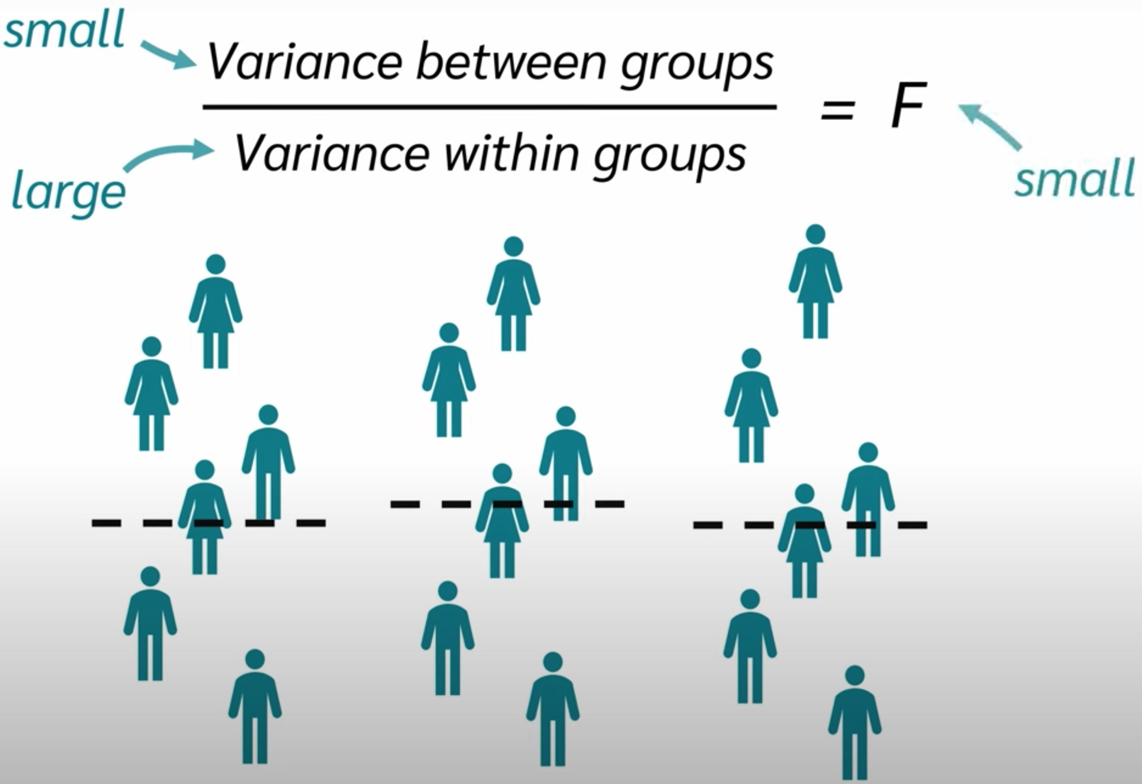
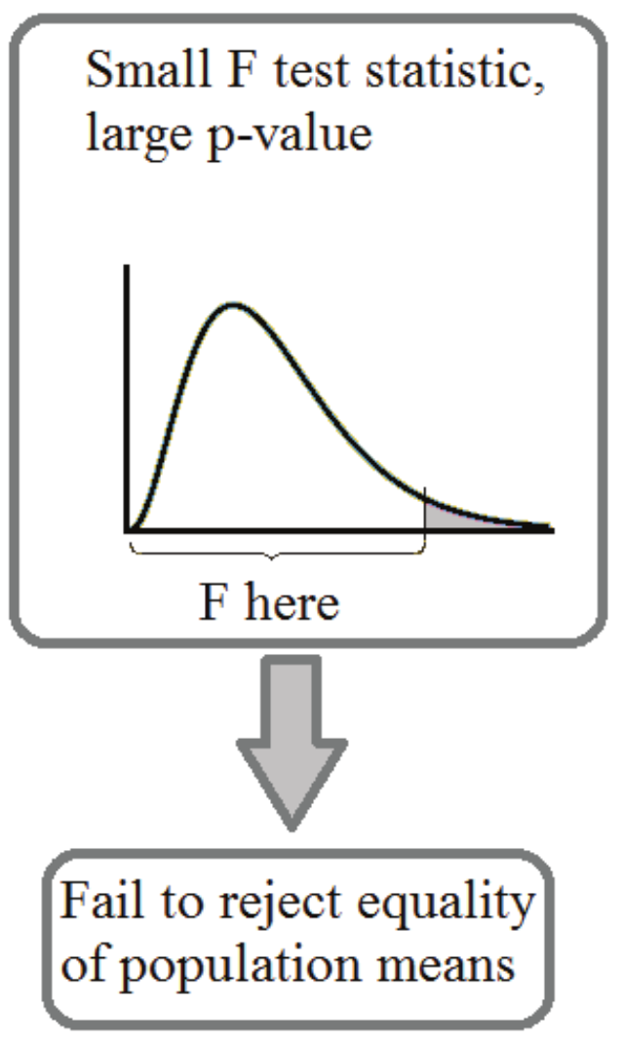
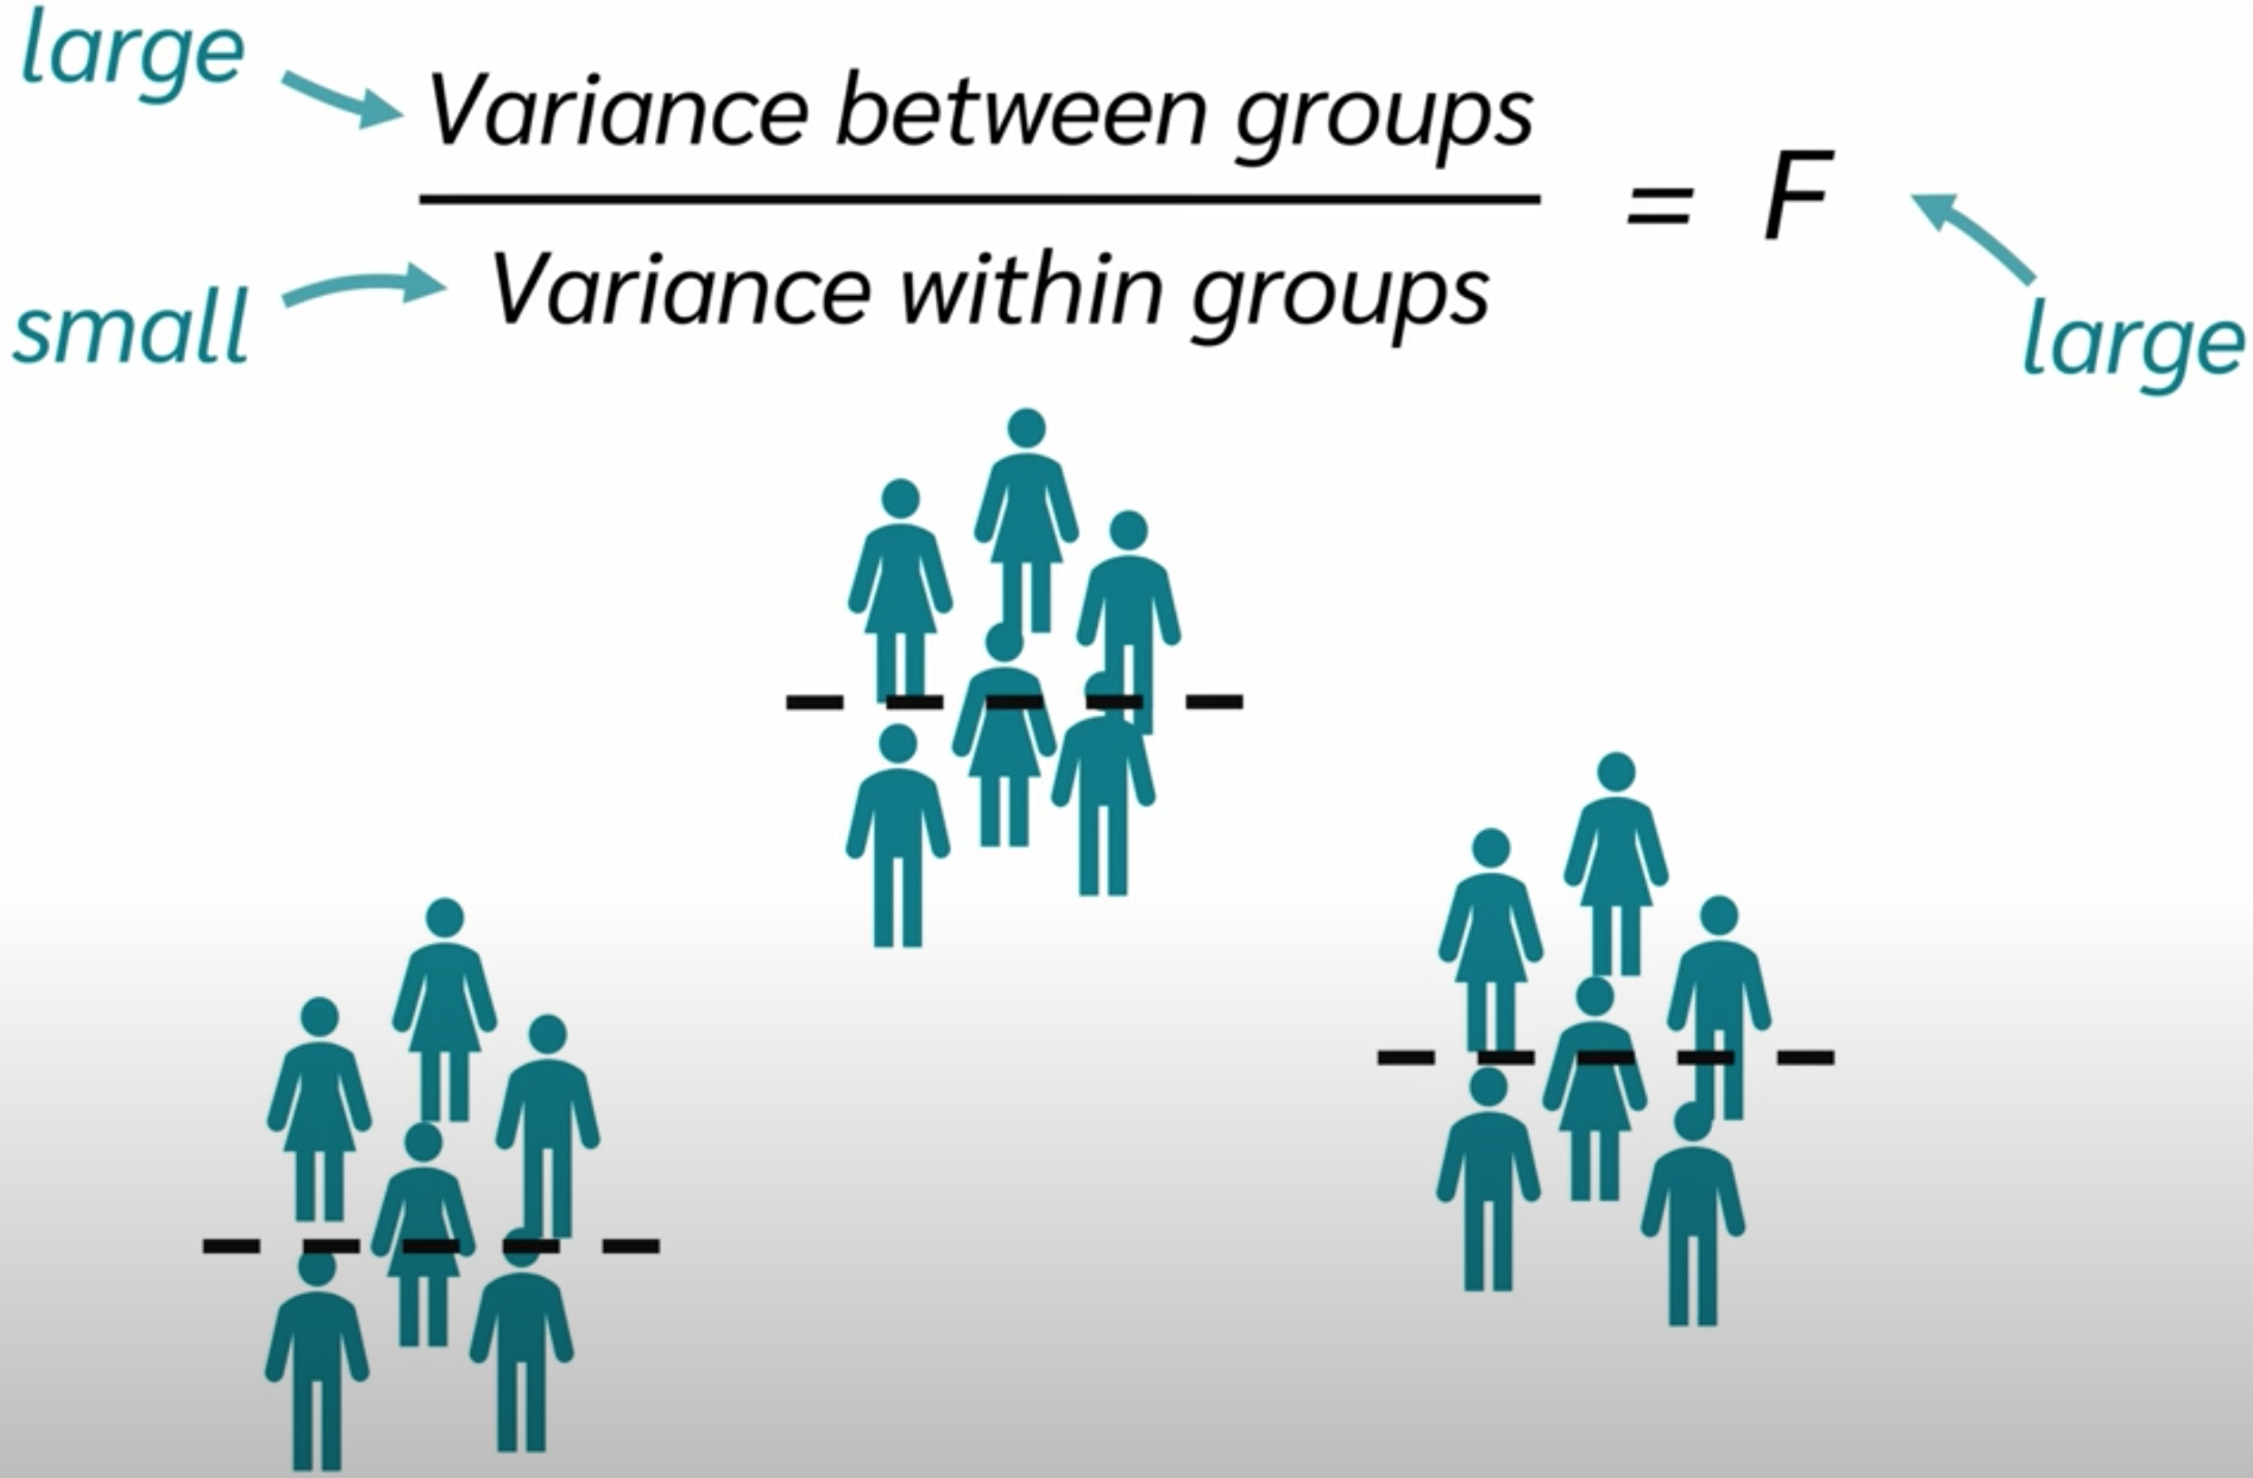
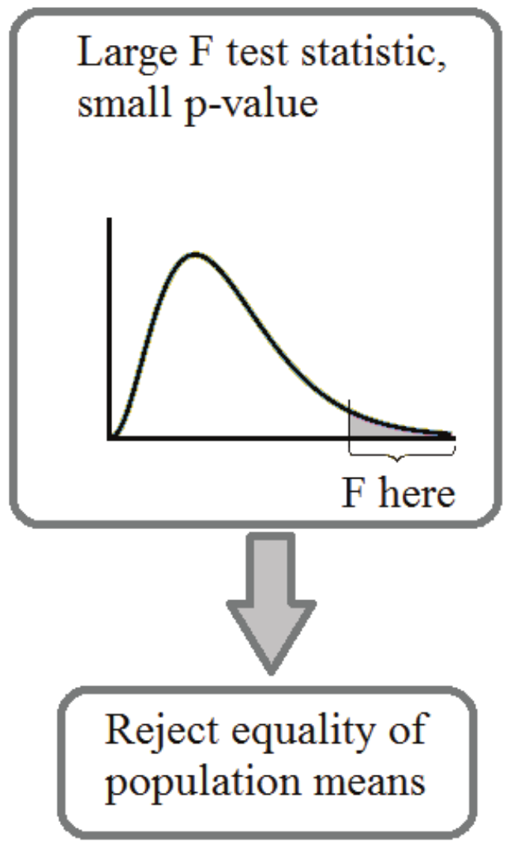
ANOVA – Making a Decision using P-values
Notes:
The F-statistic helps us decide if the group differences we see are real or just due to random chance.
When the groups have little variation within themselves, but large variation between them, it would appear that they are distinct and that their means are different.

Slide 18
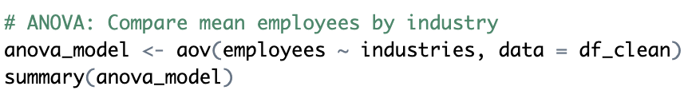
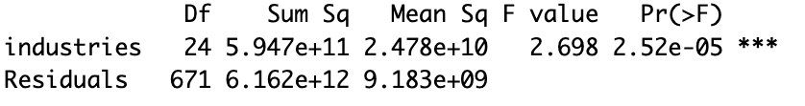
Example using P-values
Is there a statistically significant difference in the mean number of employees among companies from different industries in the forbes_best_employers_2023 dataset?
H₀: The Mean number of employees is equal across industries.
H_{A}: At least one industry's mean is different.
Result: p-value << 0.05 → Reject H₀
Interpretation: Industry distribution differs significantly by country.

Slide 19
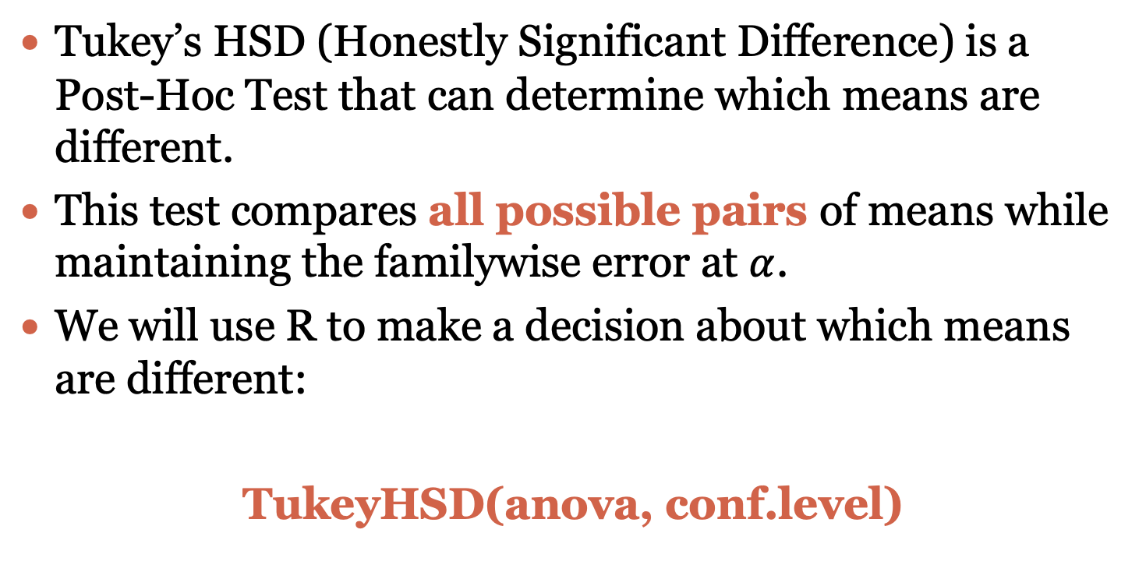
Tukey’s HSD
Tukey’s HSD (Honestly Significant Difference) is a Post-Hoc Test that can determine which means are different.
This test compares all possible pairs of means while maintaining the familywise error at $α$.
We will use R to make a decision about which means are different:
TukeyHSD(anova, conf.level)
Notes:
The results of ANOVA tells us is that there is a significant difference between two or more means, but not which means.
To find out where the significant differences lie, we need to carry out a Post-Hoc analysis.

Slide 20
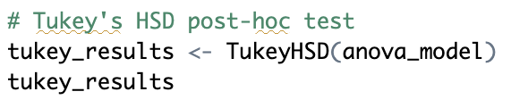
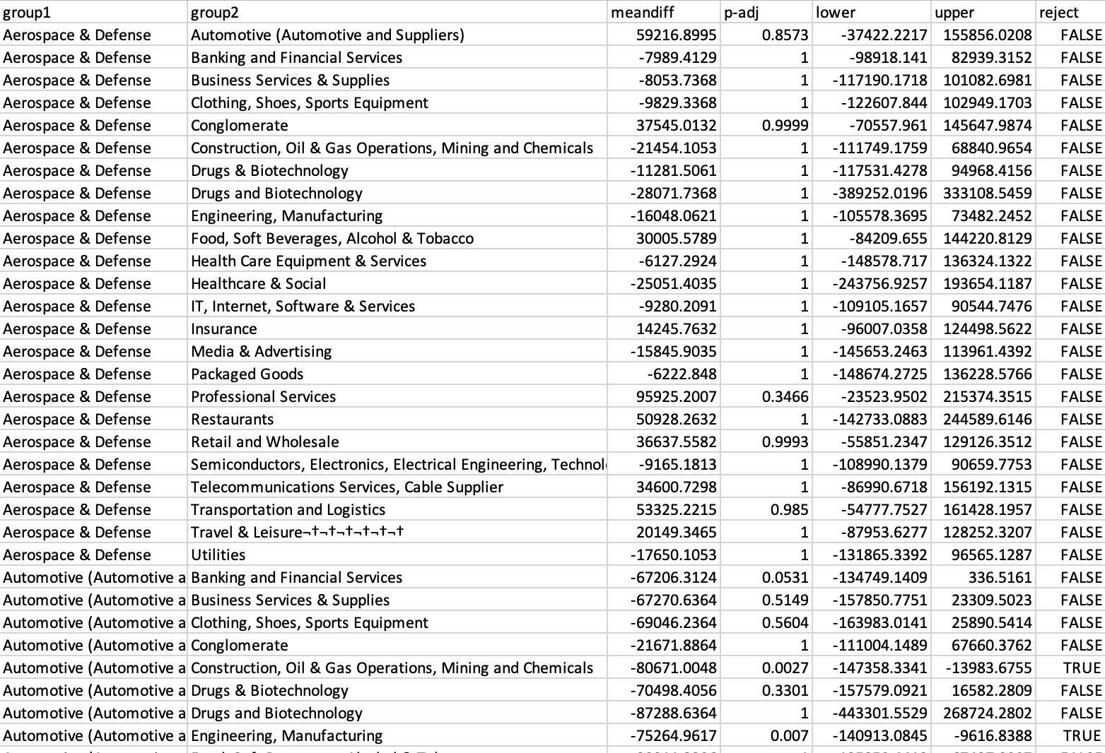
Example – Tukey’s HSD
If there is a significant difference in the mean number of employees among industries, which specific industries differ from each other in terms of their average number of employees?
If p adj < 0.05, the difference between those two groups is statistically significant.

Slide 21
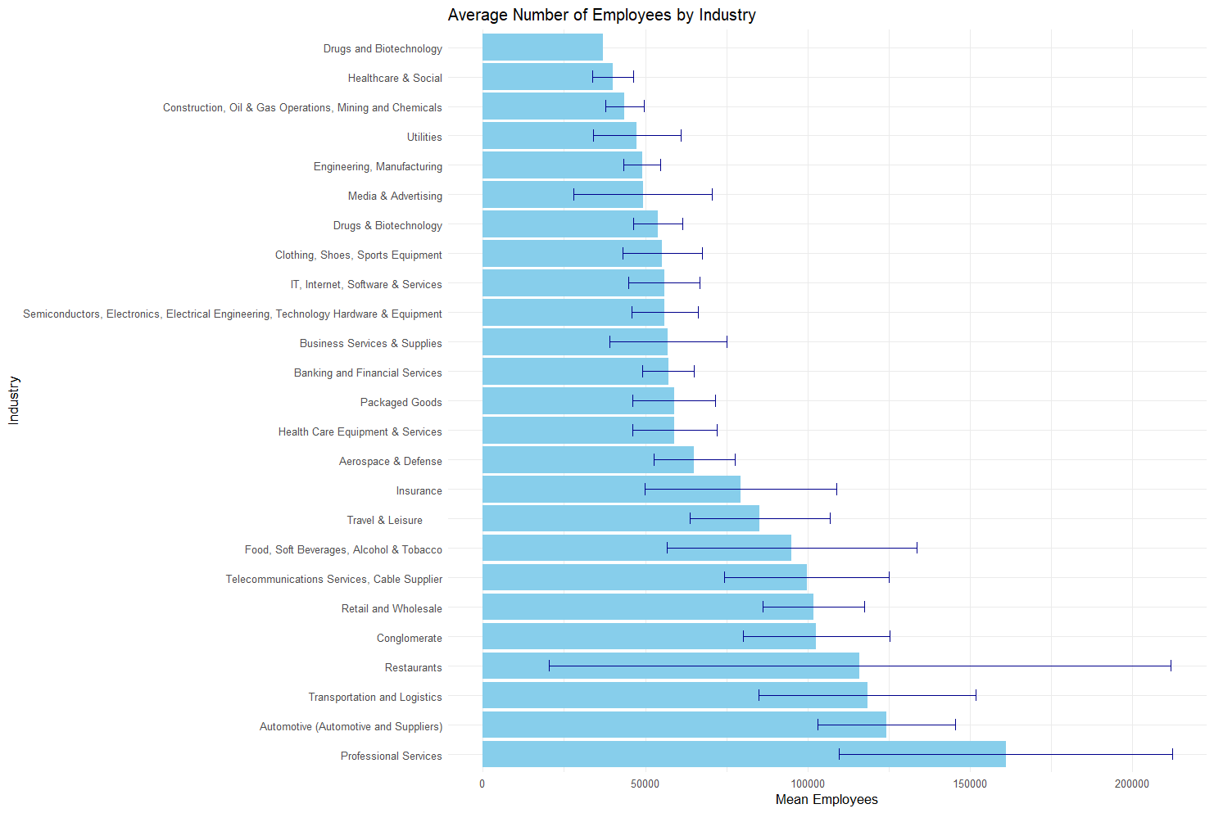
Bar Plots of Group Means
A bar plot can be created to show the size of the mean for individual groups and to compare the size of the means.
“Error bars” are added to show the 95% confidence interval for the mean.
In this Module we will make bar plots for more than 2 means.
If the error bars DO NOT overlap, it's a sign that the group means might be statistically significantly different.
If they do overlap, it suggests there may not be a significant difference.
Notes:
Boxplots help visualize how scores are distributed across groups. They’re great for spotting variance and outliers.

Slide 22
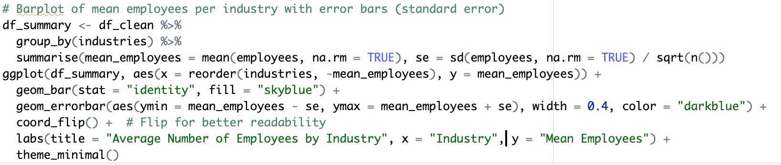
Example: Barplot of mean employees per industry with error bars
Notes:
Again this example confirms our findings that drug D is different from others in terms of effectivity.
These visual differences support our statistical findings

Slide 23
Key Takeaways
Industries are not equally represented among top employers.
Industry is significantly related to country distribution.
Average number of employees differs greatly between industries.

